Slide 1
Introduction to Data Science
Real World Examples
Data Science Jargons
Why Data Science now?
Big Data & where it fits
Life Cycle of Data Analytics Problem
Data Analytics project Framework
Spectrum of Data Analytics
Data Science Essentials
Study Path
Case Study

Slide 2

YouTube Auto play

Slide 3
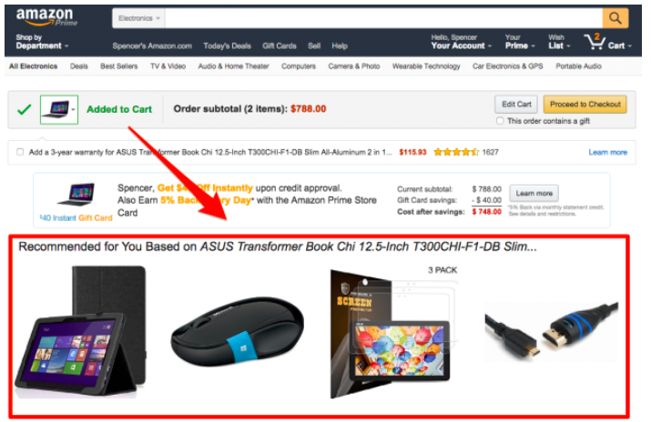
Amazon Recommendation

Slide 4

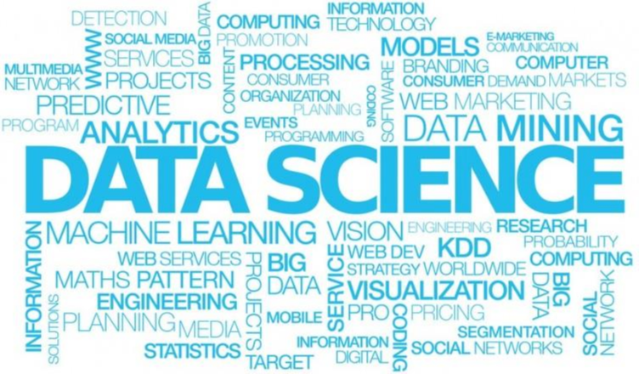
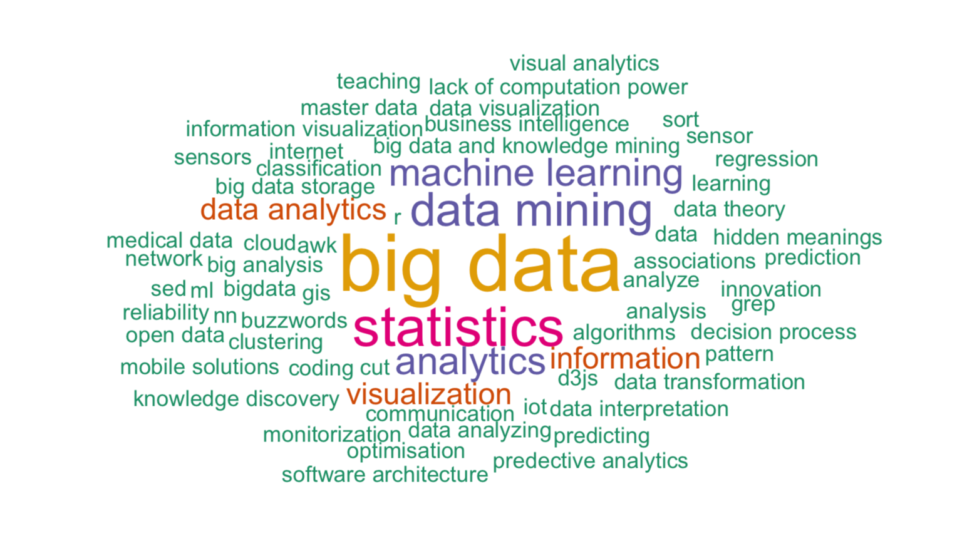
Data Science/ ML-AI / Business Analytics

Slide 5
Formal Definition
“Business Analytics can be defined as the
broad use of data and quantitative analysis for
decision making within organizations”.
Thomas H Davenport

Slide 6
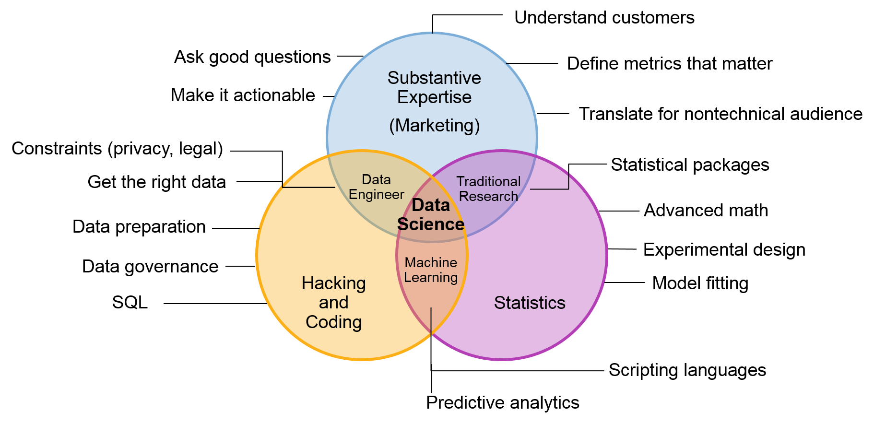
What is Data Science?

Slide 7
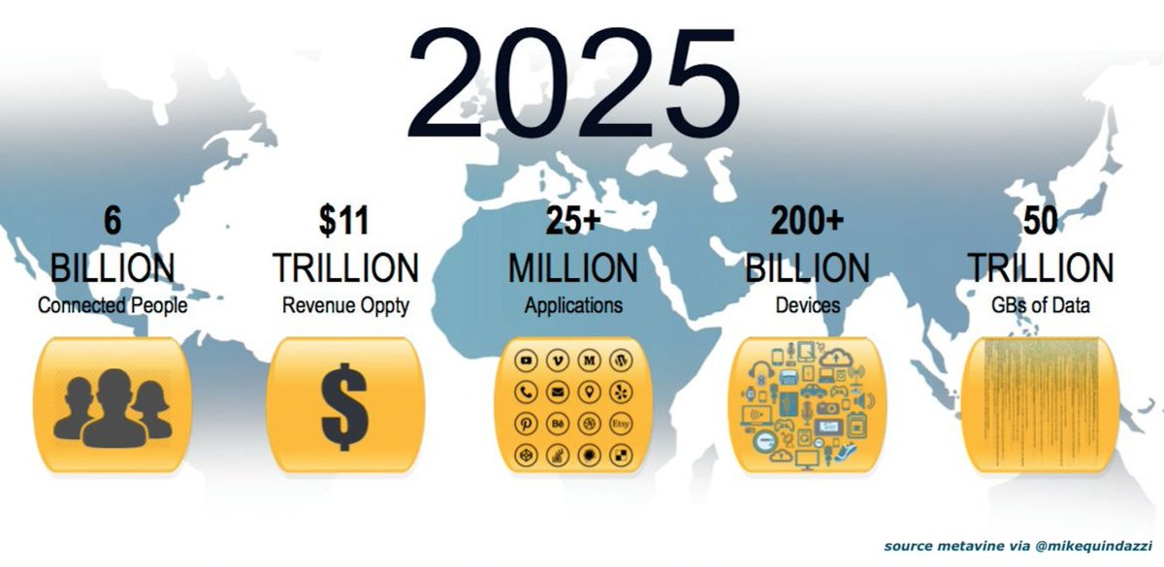
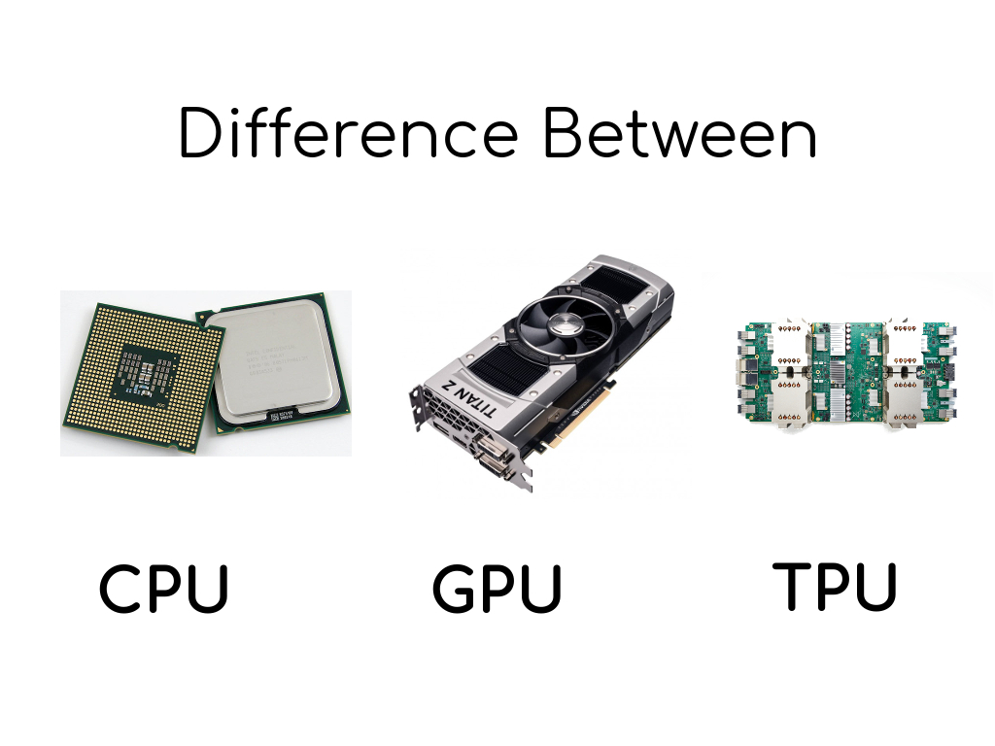
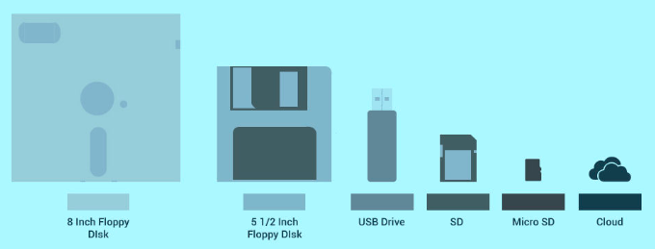
What is Changed?
Data & its velocity
Computation Power
Storage

Slide 8
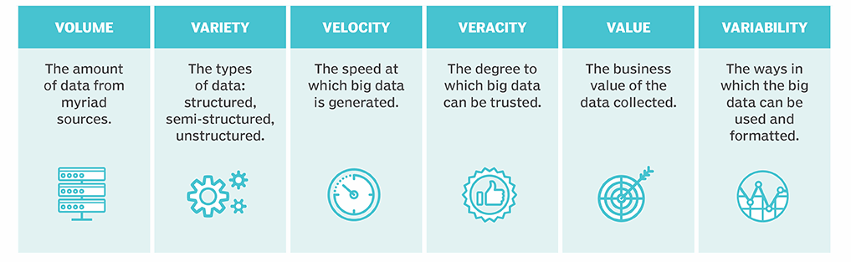
The Six V’s of Big Data
Walmart handles over one million purchase transactions per hour.
Facebook processes more than 250 million picture uploads per day.

Slide 9

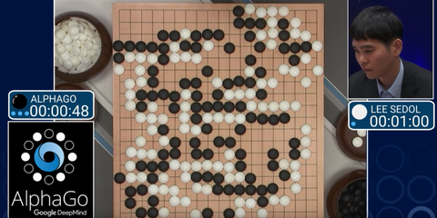
Stories
Target Corporation is the eighth-largest retailer in the United States, and is a component of the S&P 500 Index
AlphaGo is a computer program that plays the board game Go.
It was developed by DeepMind Technologies which was later acquired by Google

Slide 10
Lifecycle of Data Analytical problem
Problem Identification
Hypothesis Formulation
Data Gathering
Data Analysis
Implementation

Slide 11
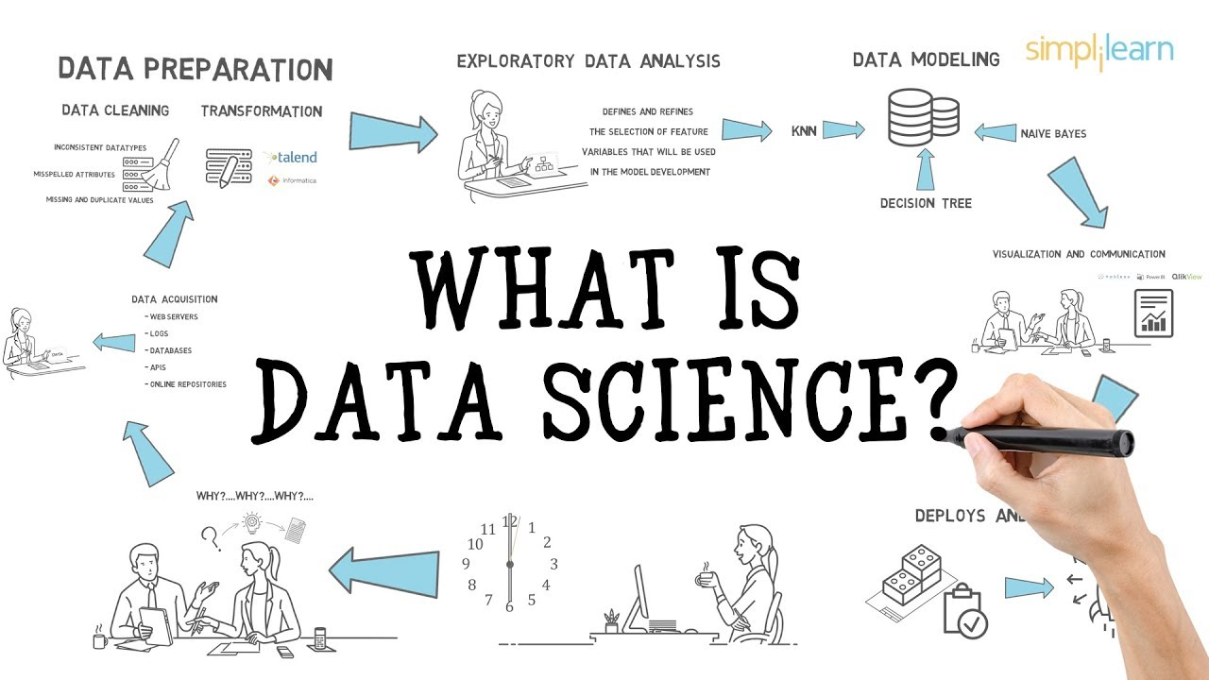
What is Data Science?

Slide 12

Feel the change Data Science could bring
Q2: What is the relationship between AI, ML, & DL,
And Data Science?

Slide 13
Questions

Slide 14

Now do you have idea about AI, ML, Business Analytics, and Data Science?

Slide 15
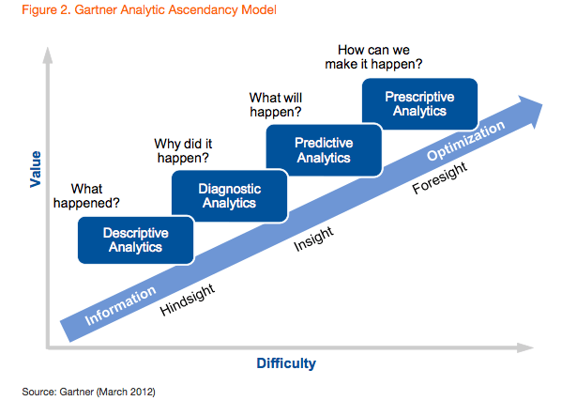
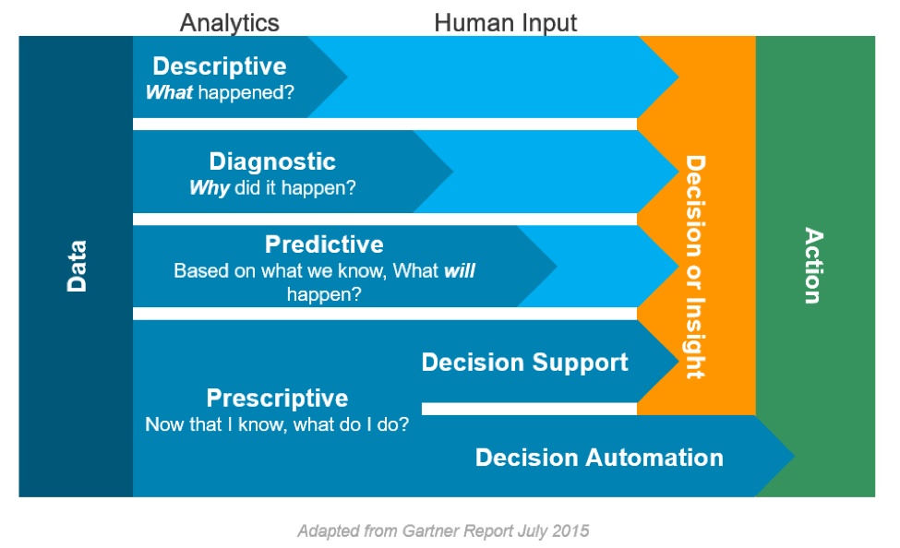
Data Science Project Framework
Data Science – D2P2 Framework
Analytics, Human Inputs & AI/ Machine Learning
Data Science
AI

Slide 16
Spectrum Of Data Analytics
Optimization
Decision Analysis
Prescriptive
Simulation
Predictive Modeling
Forecasting
Predictive
Competitive Advantage
Data Mining
Data Query
Data Visualization
Diagnostic
Descriptive Statistics
Descriptive
Standard Reporting
Degree of Complexity

Slide 17
What is Data Science?
Tableau
Power BI
Qlik
Data Visualization
Clustering
Classification
Un-supervised Learning
Data Science
Supervised Learning
Regression
Association Rules
Time Series
Non Traditional Data
Text
Image/ Video
Audio

Slide 18






Programming Languages

Slide 19
Minimum Requirement
Data Science Minimum
Math/ Statistics
Ethical Skill
Team Player Skills
Lifelong Learning
Communication Skill
Real World Project
Machine Learning
Data Visualization
Data Wrangling & Processing
Coding Pyhton or R

Slide 20
Data Science Essentials
➢ Maths / Stats orientation
➢ 1 programming language – Python or R
➢ 1 Cloud based platform (Nice to have) – AWS, Azure, Google Cloud
➢ Competition / Hackathon - Kaggle, Analytics Vidhya etc.
➢ Database / SQL knowledge

Slide 21
Questions

Slide 22
Study Path
➢ Basic Statistics & Advance Statistics
➢ 1 programming language – Python or R – We can vote for which to choose
➢ Optimization Technique
➢ Unsupervised Learning
YouTube
➢ Supervised Learning
Analytics Books
➢ Time series Analysis
Kaggle
➢ Data Visualization
Study Group
➢ Deep Learning
➢ Big Data Analytics

Slide 23
Feedback Form

